Slide 1
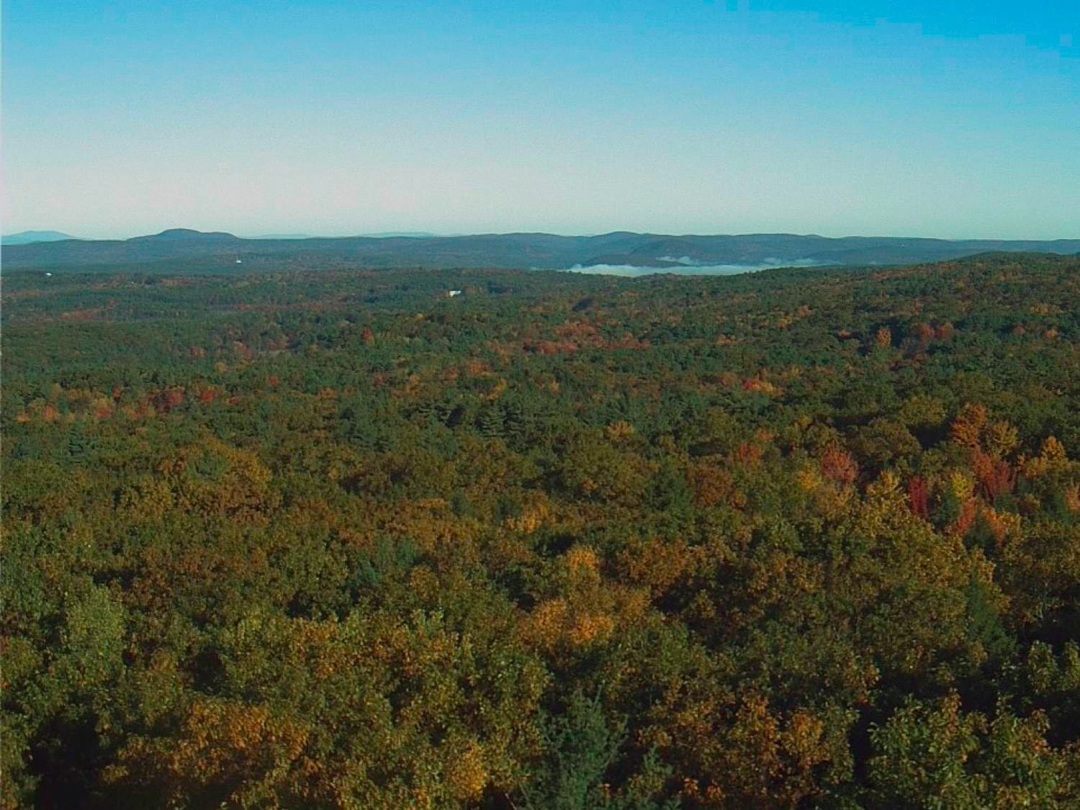
PhenoCam data for validation of remotely sensed VIs Bijan Seyednasrollah & Andrew D. Richardson Northern Arizona University
CEOS LPV Workshop • Washington DC
12 December 2018

Slide 2
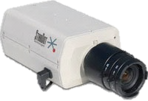
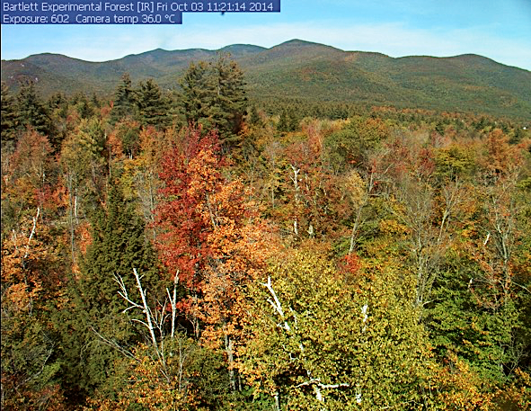
The PhenoCam Network: Near-surface remote sensing of vegetation phenology
PhenoCam uses imagery from networked digital cameras for continuous monitoring of plant canopies
Images recorded every 30 minutes, sunrise to sunset, 365 days a year
Scale of observations is comparable to that of tower-based flux measurements
A direct link between what is happening on the ground and what is seen by satellites
Bartlett Experimental Forest
Notes:
So the PhenoCam network does what we refer to as
***
Tower-based flux measurements, stand-level forest inventories, and small watershed measurements
So this gives us a direct link…

Slide 3
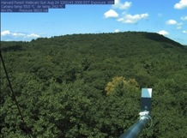
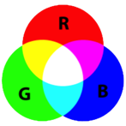
Quantitative analysis of camera imagery (Richardson et al. Oecologia 2007; Sonnentag et al., AFM 2012)
RGB Triplet
Canopy “Greenness”
RGB Color Model
Harvard
Forest
Canopy Greenness
2008
2009
2010
2011
2012
2013
Notes:
Digital camera images use the the red-green-blue additive color model, which says that we can reproduce any color through some combination of the three primary colors
We can split each image into these three components, and for a particular region within each image, quantify the intensity of each, and develop a quantitative measure of canopy greenness.
This graph shows six years of canopy greenness derived from imagery from the Harvard forest. Greenness is low in the winter, rises steeply in spring, drops off gradually over the summer, and falls sharply in autumn. These transitions correspond to dates of leaf out, peak canopy development, and autumn coloration, as recorded by an observer, based on visual assessment of phenology. So our camera-based method is providing data that is consistent with ground observations, but automatically, and at a much higher temporal resolution.

Slide 4
The same method works in other ecosystem types
Canopy greenness
Mixed, C3/C4 Grassland at 3000’ on the western flank of Mauna Kea, on the Big Island of Hawaii
Seasonality of vegetation greenness driven by timing and magnitude of precipitation events
KamuelaCam, Waimea
Notes:
The same approach is also able to track seasonal changes in greenness of other types of vegetation. So for almost seven years we have had a camera looking at a mixed C3/C4 grassland located at 3000 feet on the western flank of Mauna Kea, on the Big Island
Here, seasonality is driven by the timing and magnitude of precipitation events, and as you can see there is substantial year-to-year variaibility in the frequency and duration of green-up pulses, and again we’re able to track that, automatically and at high temporal resolution, using Phenocam imagery

Slide 5
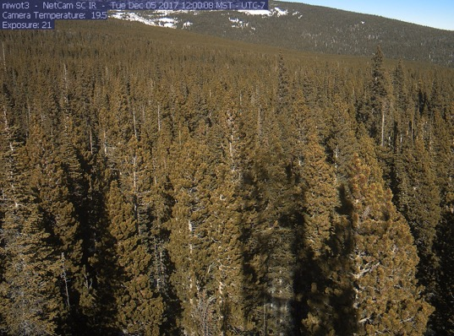
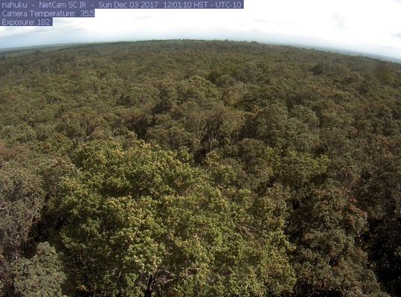
Seasonality in evergreen forests
Some are more seasonal than others…
Niwot Ridge, Colorado (3050 m elevation)
Picea engelmannii, Abies lasiocarpa, Pinus contorta)
2016 2017
Nahuku (Thurston Lava Tube), Hawaii (1200 m elevation)
Metrosideros polymorpha, Ilex anomala, Cibotium spp.
2016 2017
Notes:
But in other evergreen ecosystems, the seasonality is not so pronounced.
***
Here are two y of data from a camera set up at Volcano National Park on the Big Island of Hawaii
The y axis range is the same as for the Niwot data
And you can see that there are are some changes in greenness, but the amplitude is much smaller than at Niwot

Slide 6
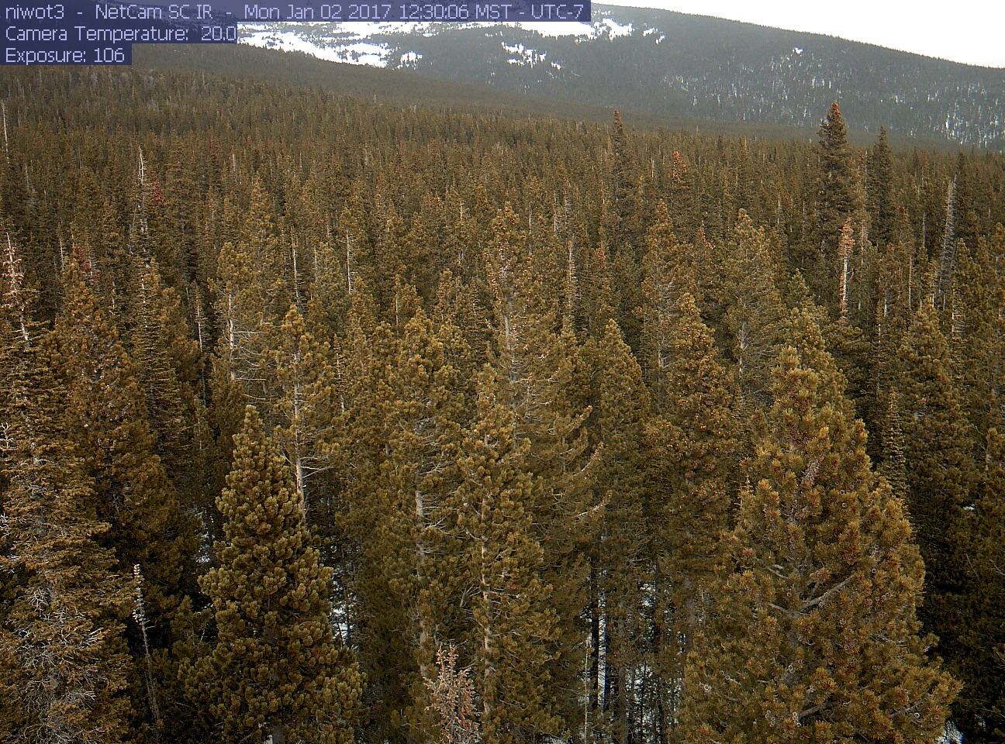
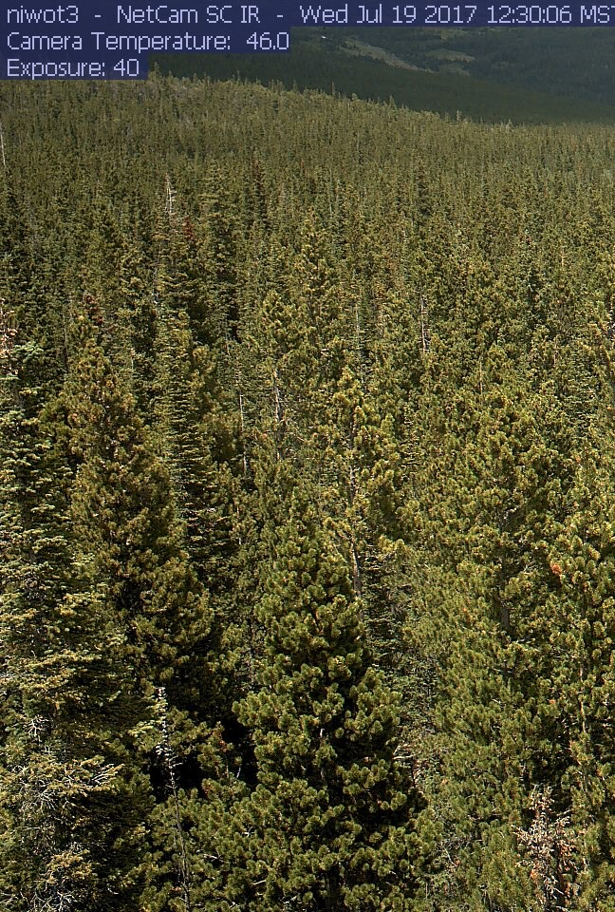
July
January
Notes:
And you can see very clearly here just how much greener the foliage is in July, and how much browner it is in January

Slide 7
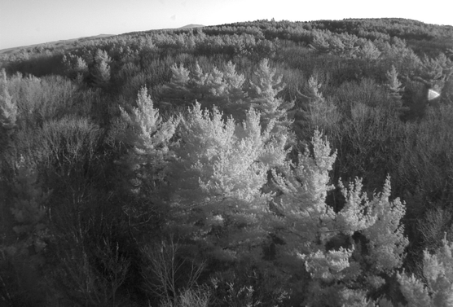
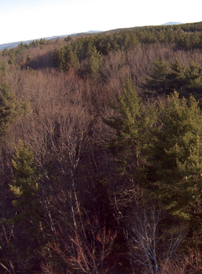
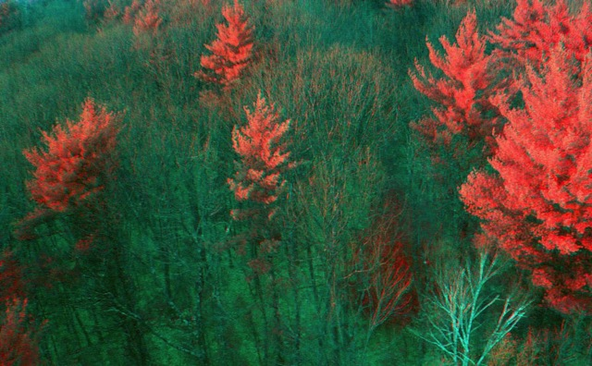
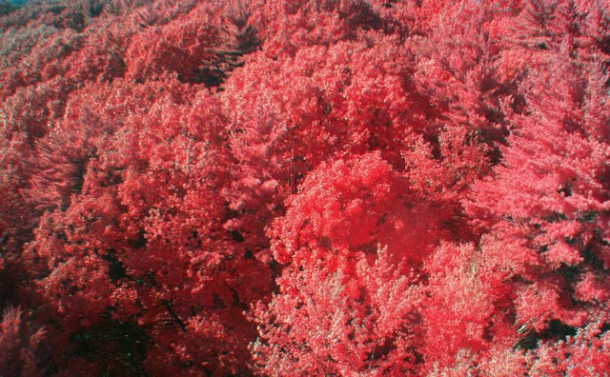
Leveraging camera near-infrared (NIR) capabilities (Petach et al., Agricultural & Forest Meteorology 2014)
CMOS sensor is sensitive to λ > 700 nm
software-controlled filter enables sequential VIS (RGB color) and VIS+NIR (monochrome) images
Potential applications
false color images
“camera NDVI” as alternative to GCC
VIS
VIS+NIR
Winter
Summer
Notes:
If you use remote sensing at all you may be wondering about whether we can get information about near infrared wavelengths from our camera imagery. And in fact, we’ve also figured out how to turn our RGB – red green blue – cameras into inexpensive four channel imaging sensors that have a near-infrared band
So the CMOS imaging sensor that is standard in most digital cameras is sensitive to wavelengths of light beyond what can be seen by the human eye – near infrared wavelengths of 700 nm and longer
These wavelengths are typically blocked by a special filter, but in our camera we can control that filter via software, and this enables us to take sequential images – the first a visible-wavelgnth image, and the second a visible plus nearinfrared image. By differencing the two, we can pull out the near infrared band.
This has several neat applications, including producing false color images of the sort you see here on the bottom, where green vegetation is shown as luminous pink, and also it allows us to calculate a vegetation index that is analogous to the normalized difference vegetation index standard in satellite remote sensing.

Slide 8
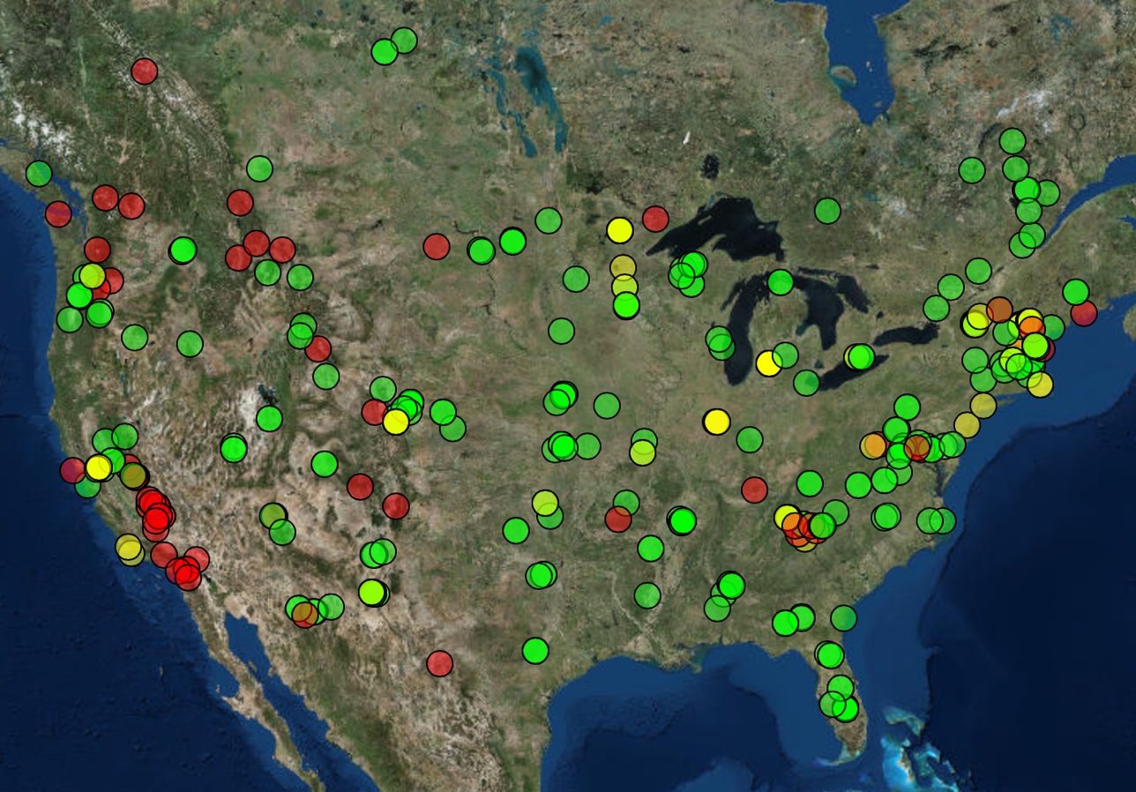
2018: A network of over 500 cameras
Imagery and data available at: http://phenocam.sr.unh.edu/
Notes:
So we now have over 400 cameras contributing imagery to the PhenoCam dataset. Most of these are lcoated within the United States, and we have cameras across the country, from Hawaii to Maine and from Alaska to Florida, as well as cameras in Canda, Panama, and a number of countries in Europe.
The imagery and data from these cameras is all publicly available through our web page…

Slide 9
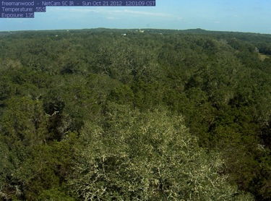
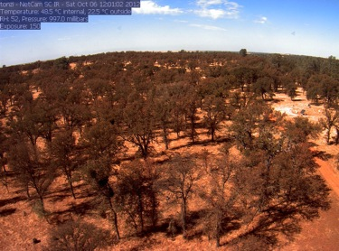
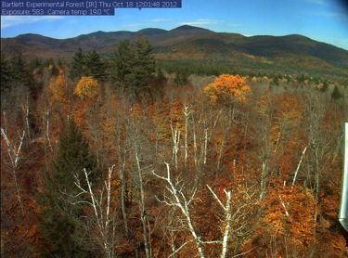
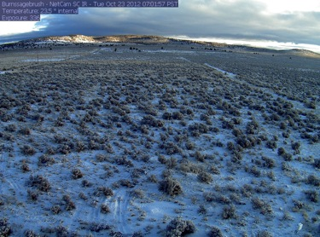
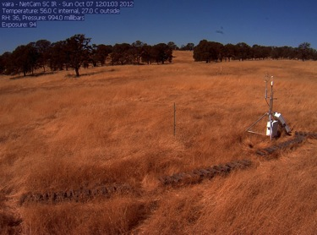
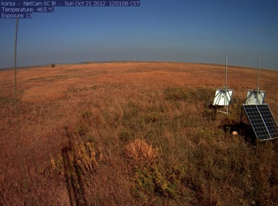
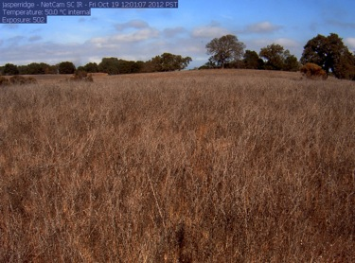
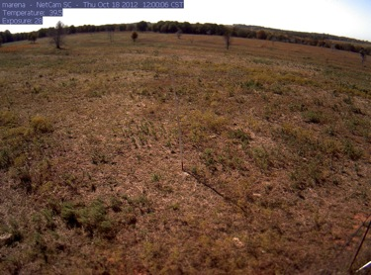
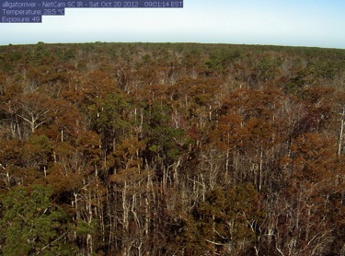
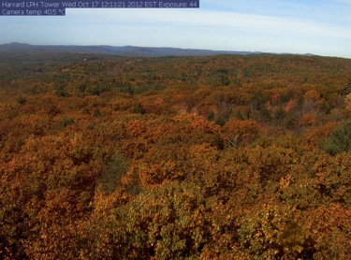
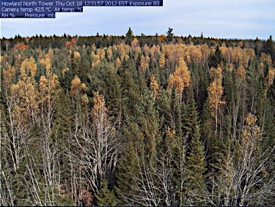
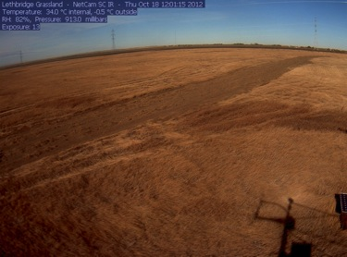
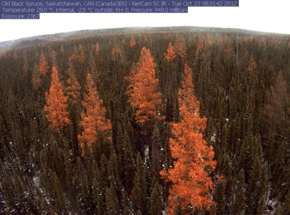
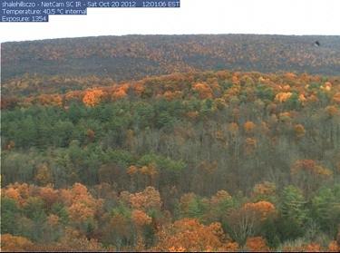
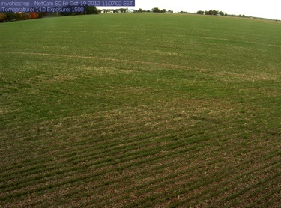
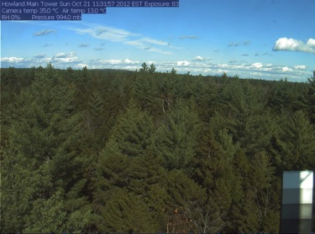
Notes:
Here are sample images from a variety of ecosystem types, including grasslands and prairie, savannah and shrublands, deciduous and evergreen forests, as well as agricultural crops.
Our ultimate goal is to have a comprehensive sampling of all the diverse ecosystem types of North America.

Slide 10
PhenoCam is also archiving, processing and distributing imagery from cameras in all NEON domains

Slide 11
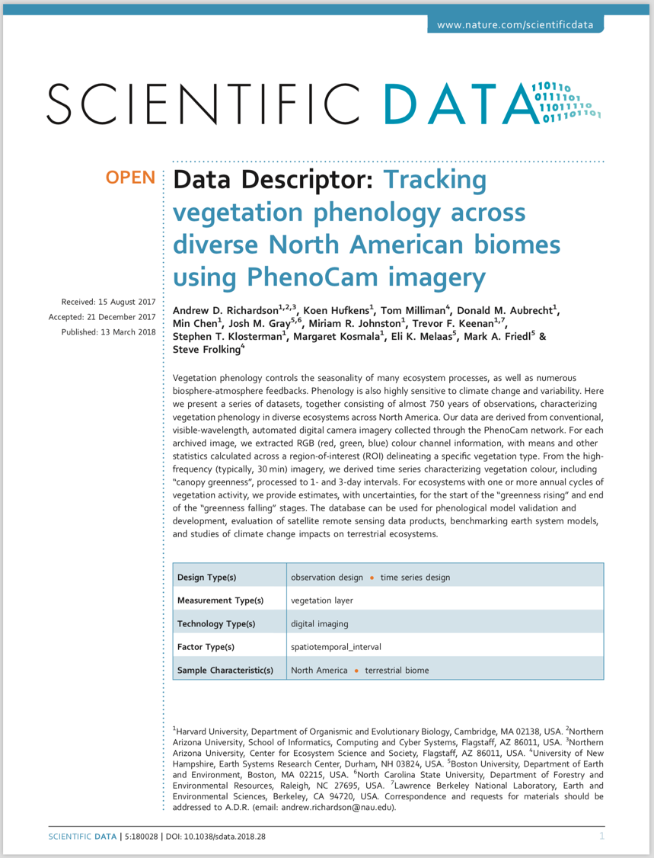
PhenoCam Dataset V1.0
125 sites, 750 site-years, fully processed and quality controlled
Data and imagery posted to ORNL DAAC
Available under CC0 Public Domain Dedication
Fully documented in Scientific Data publication published in 2018

Slide 12
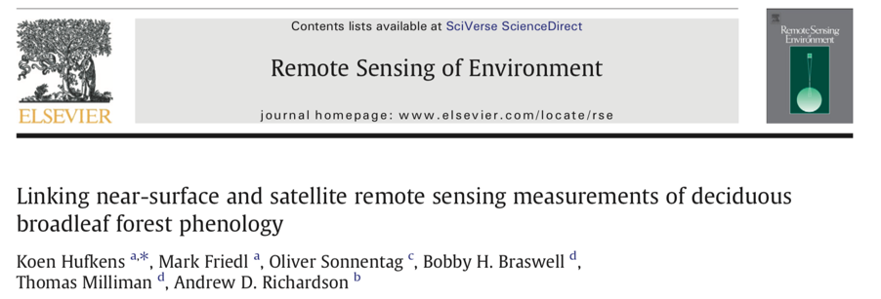
Some examples of RS product evaluation

Slide 13
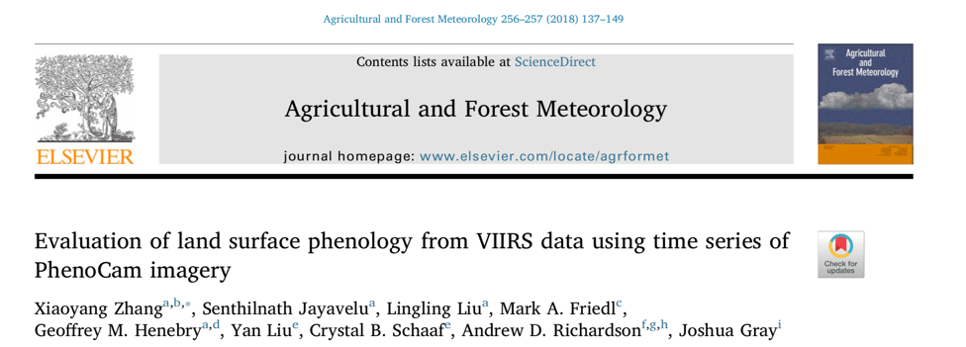
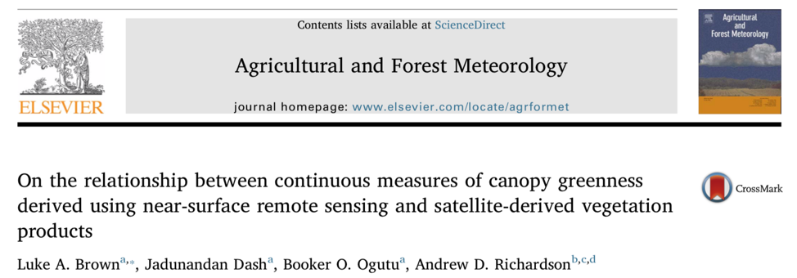
Notes:
Read these papers ahead of time so you are familiar with the analysis and satellite products used.

Slide 14
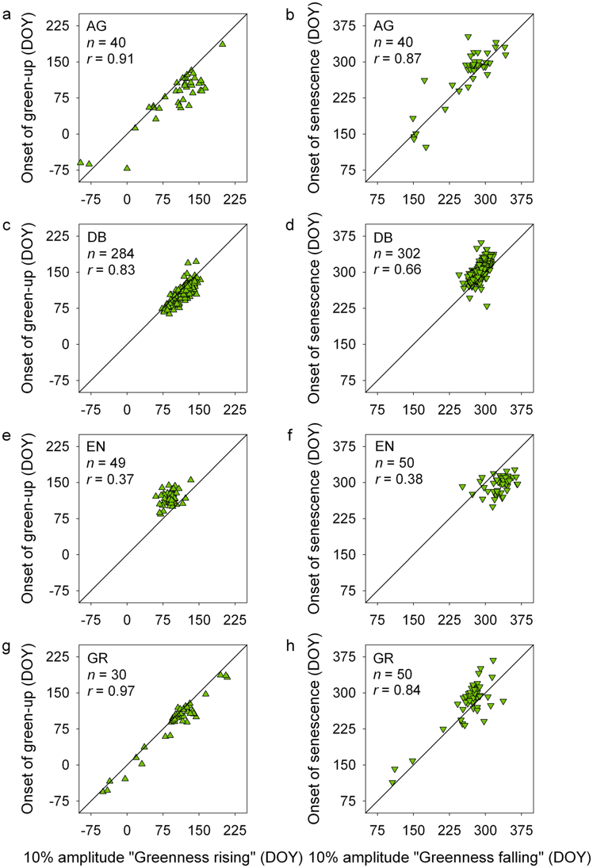
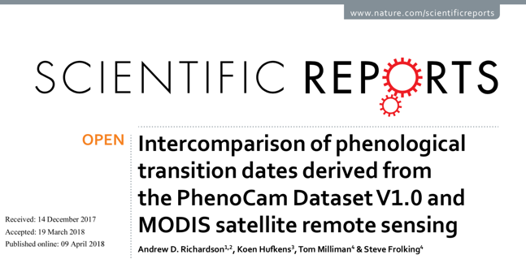
Used 600 site-years of data from PhenoCam Dataset v1.0
During both “greenness rising” and “greenness falling” transition phases, generally good agreement between PhenoCam and MODIS transition dates for agricultural, deciduous forest, and grassland sites, provided that the vegetation in the camera field of view was representative of the broader landscape.
For evergreen sites, the agreement was not so good

Slide 15
Summary & Outlook
The PhenoCam network uses networked digital cameras, and a common configuration and deployment protocol, to track vegetation phenology across North America
Data and imagery are publicly available, in near-real-time, through the PhenoCam web page:
http://phenocam.sr.unh.edu/
We are working on V2 of the PhenoCam dataset, which will consist of 1750 site-years of data from 300 sites, processed through the end of 2018
Anticipate documentation in Scientific Data and public release early in 2019
Photo courtesy of Koen Hufkens, 2015
Notes:
So just to wrap up…
**41

Slide 16
